Slide 1

New Zealand Tour
By Joshua, Tommy and Isaac
8 September, 2025

Slide 2
Introduction
  Place:New Zealand
  Duration: 2/7-19/7
  School: Rotorua English Language Academy
(RELA)
  Teachers: Mr Lam, Mr Leung, Ms Wong, Ms Chiu

Slide 3
English Lessons
  Place: Rotorua English Learning Academy
  Time: from 8:30 to 12:00
  Rela is a school that different students from the world come here to learn English language natively
  Allows us to share in front of class that helps us speak more naturally
  Customized activities for us to learn English well

Slide 4
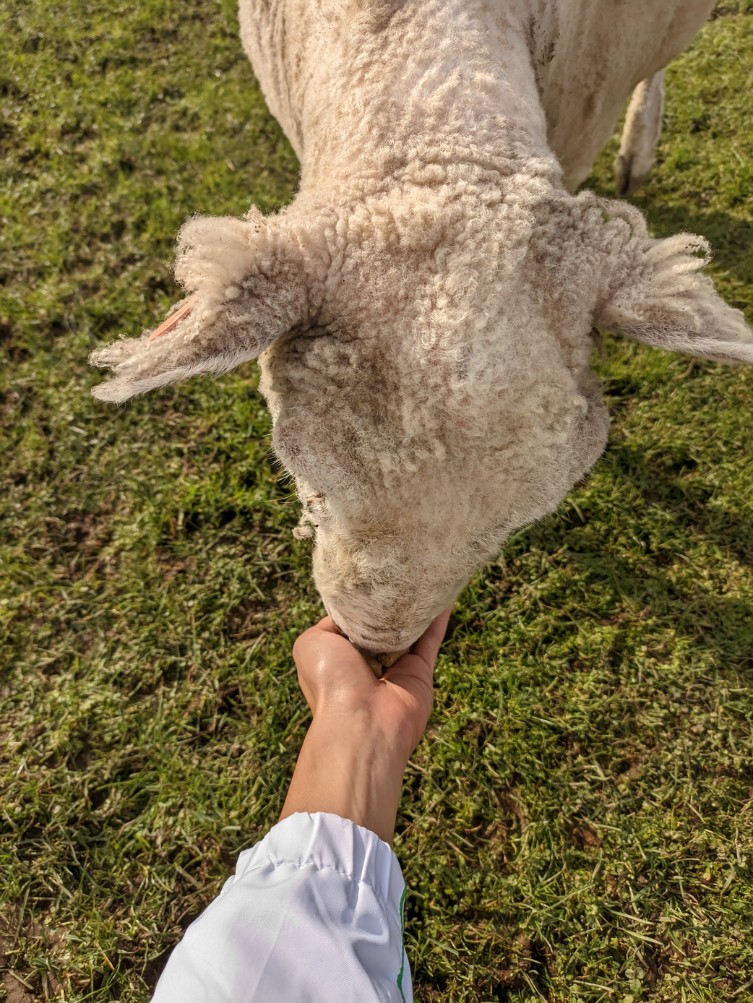
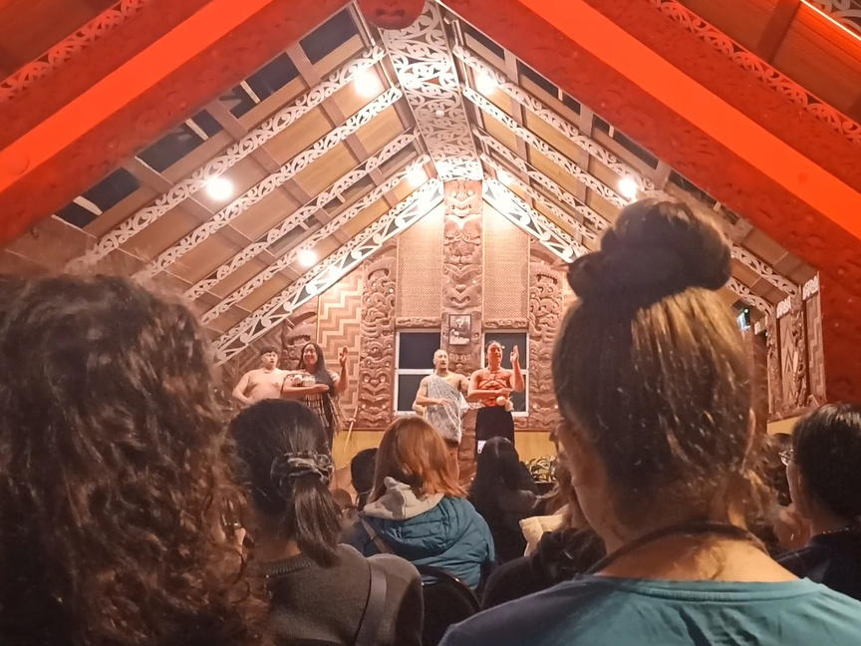
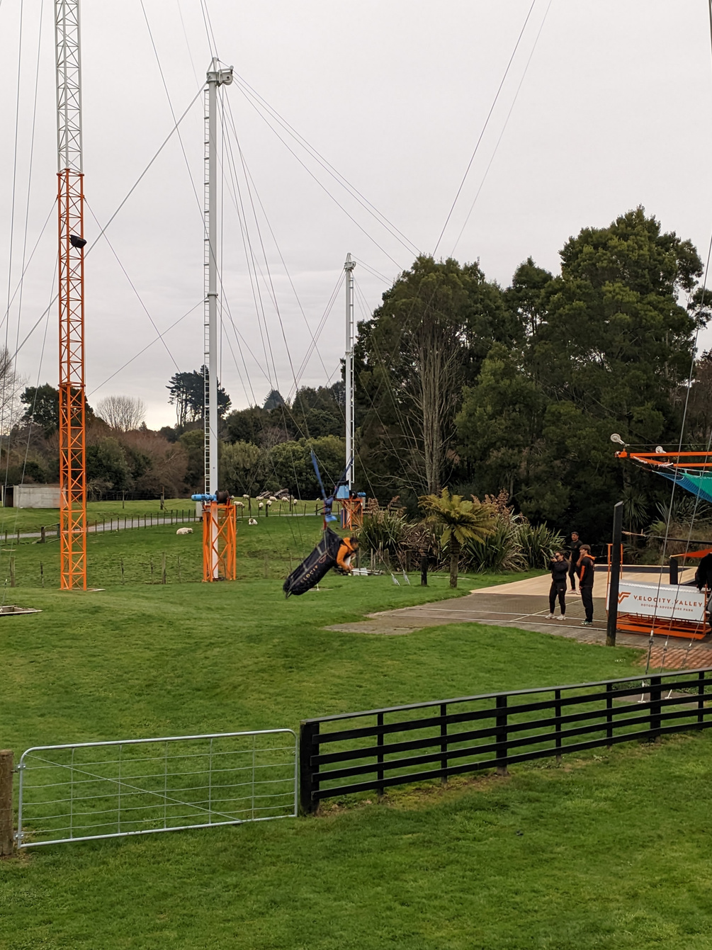
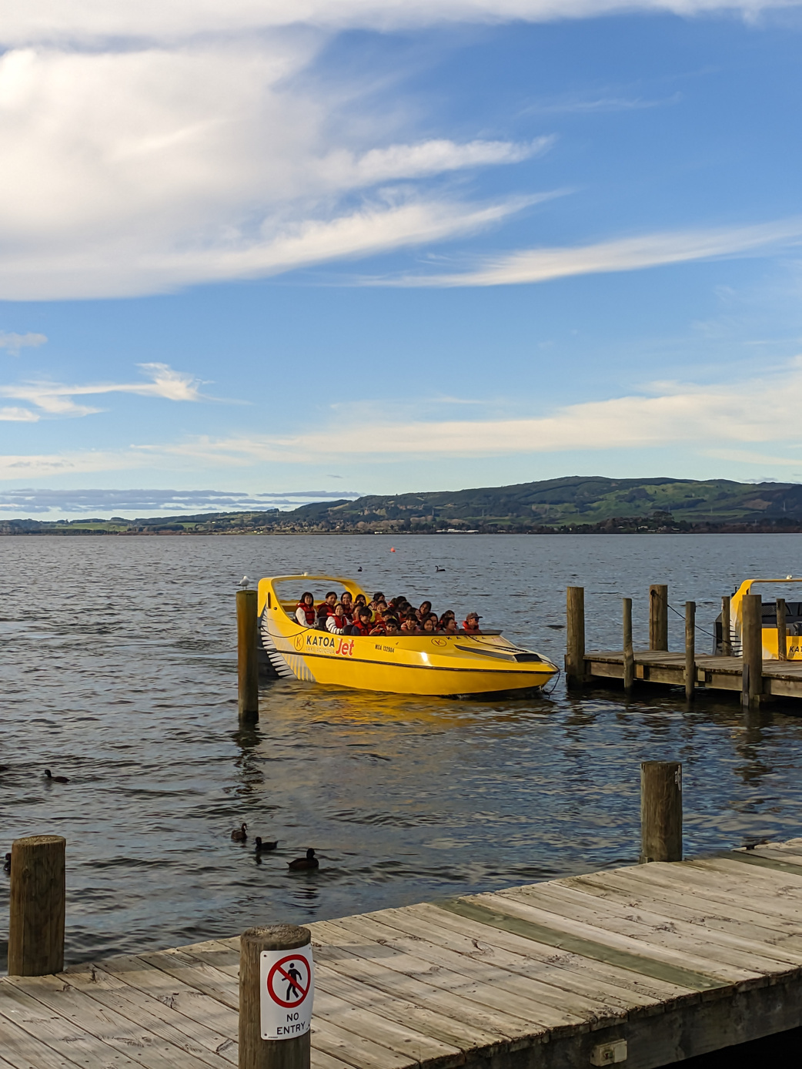
Activities
  Time: activities afternoon every weekdays
  Agrodome Farm
  A museum to explore the indigenous Māori culture
  Exciting rides like Jet Boat and Swoop

Slide 5
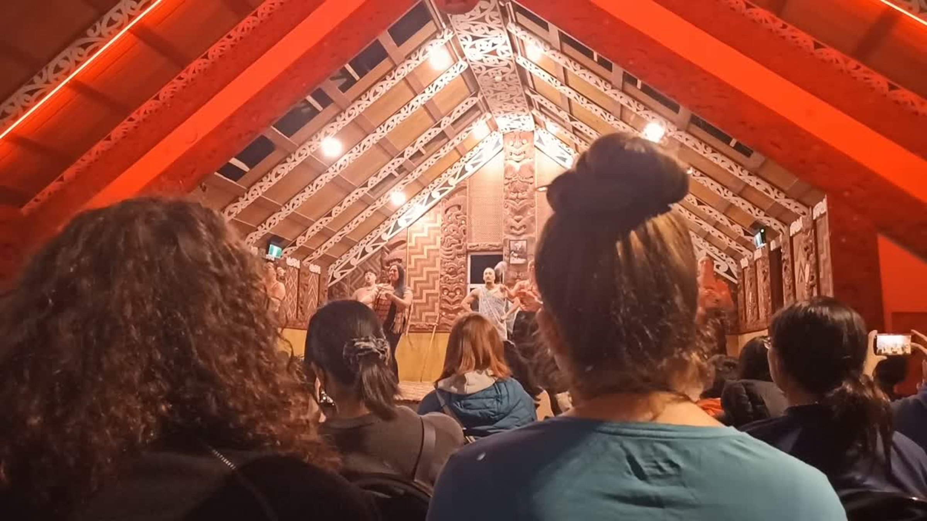

Slide 6
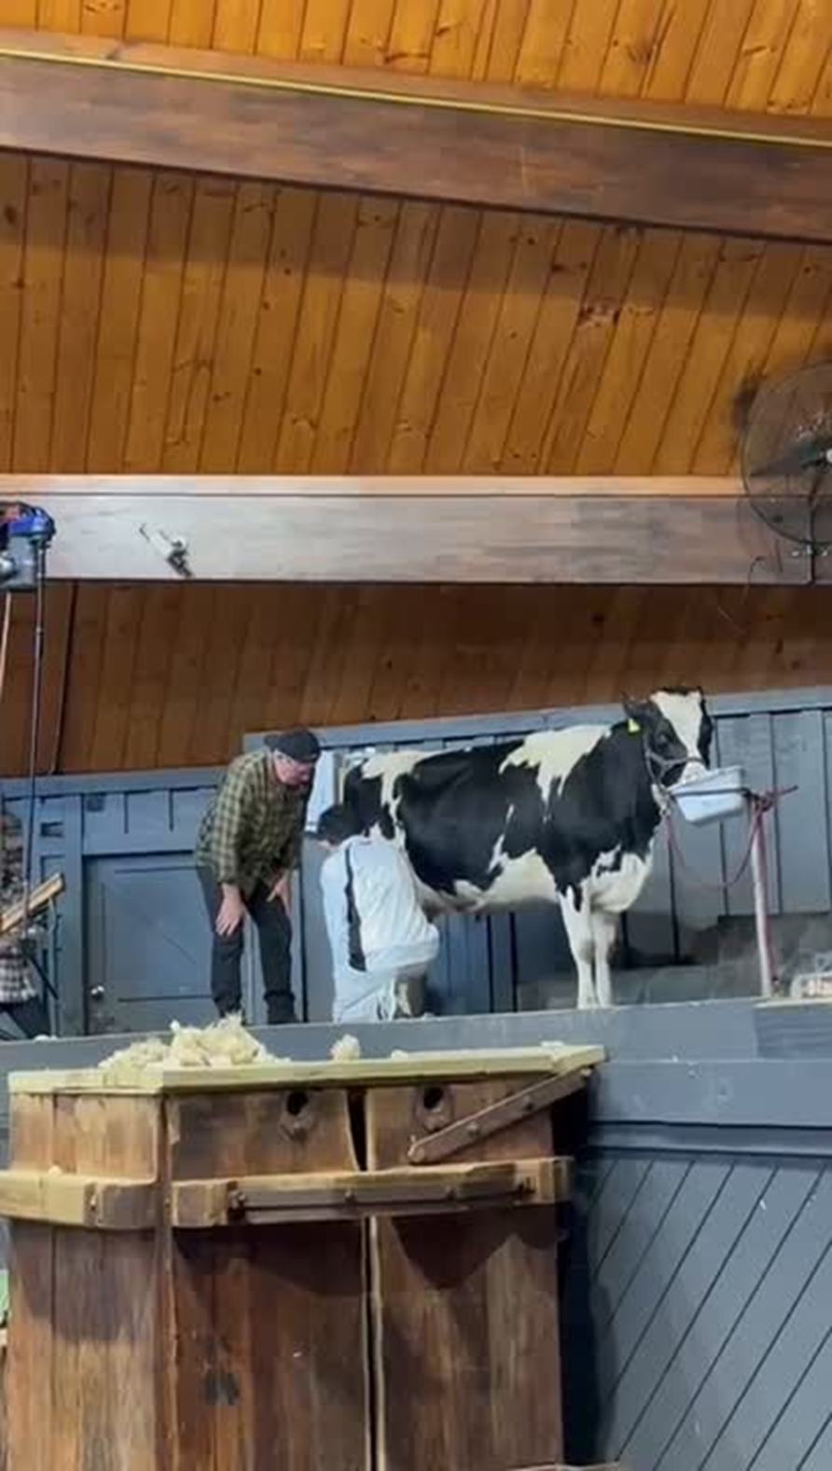

Slide 7
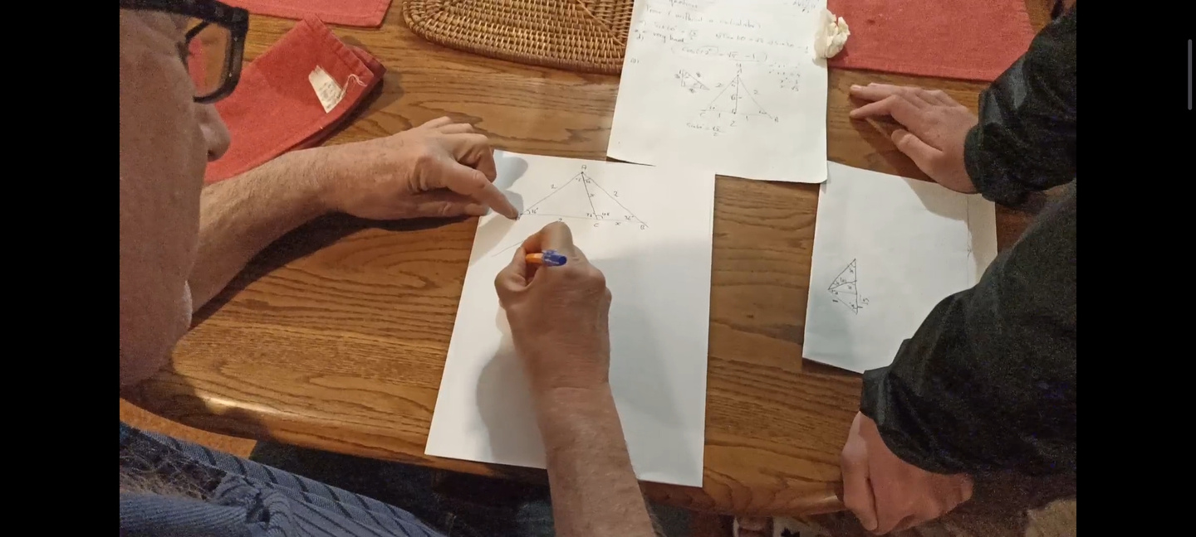
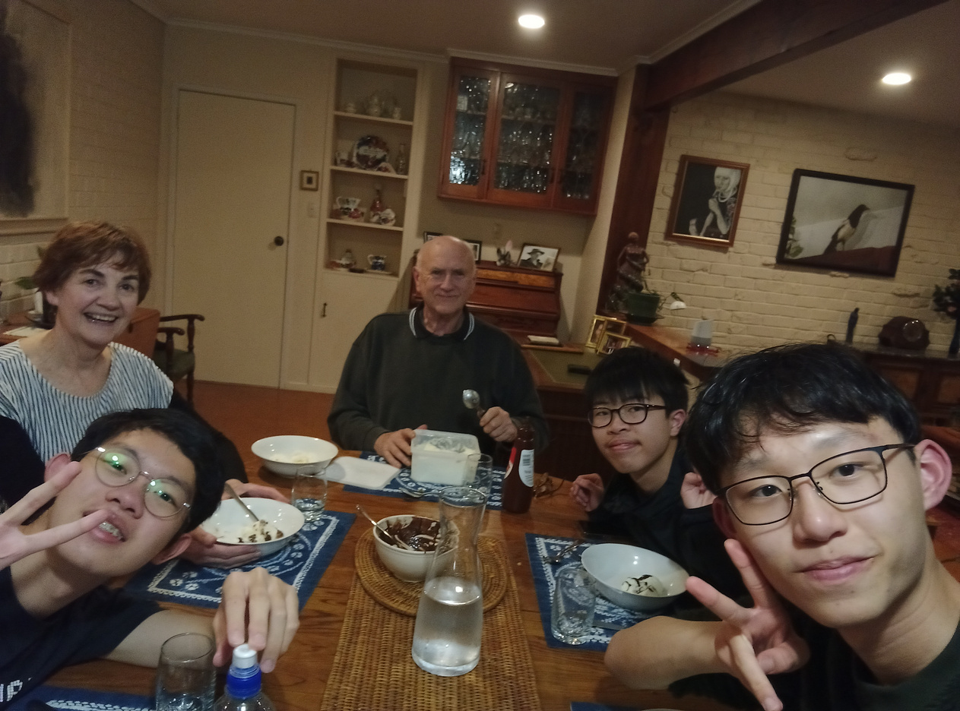
Homestay
  David&Alison
  Retired maths teacher&music teacher
  We saw hospitality from them
  Much bigger house than that in HK
  A garden with vegetables grown

Slide 8
Conclusion
  Improved English speaking skills
  Improved ability to interact with others
  Experienced lots of exotic things

Slide 9
Thank you

